Slide 1
Parallel Programming Assignment 3 –
Mandelbrot Set
Tony Wei,
LSA Lab

Slide 2

3

Slide 3
Outline
Goal
Problem Description
Input & Output format
Grading
Reference

Slide 4
Outline
Goal
Problem Description
Input & Output format
Grading
Reference

Slide 5
Goal
Knowing the differences between distributed, shared, and hybrid (distributed-shared) memory architecture
Distributed memory – MPI
Shared memory – OpenMP / Pthread
Hybrid (distributed-shared) memory – MPI + OpenMP
Knowing the importance of load balance
static vs. dynamic scheduling
Knowing how to analyze the performance of a parallel program

Slide 6
Outline
Goal
Problem Description
Input & Output format
Grading
Reference

Slide 7
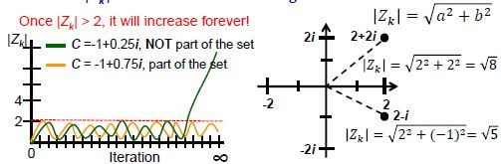
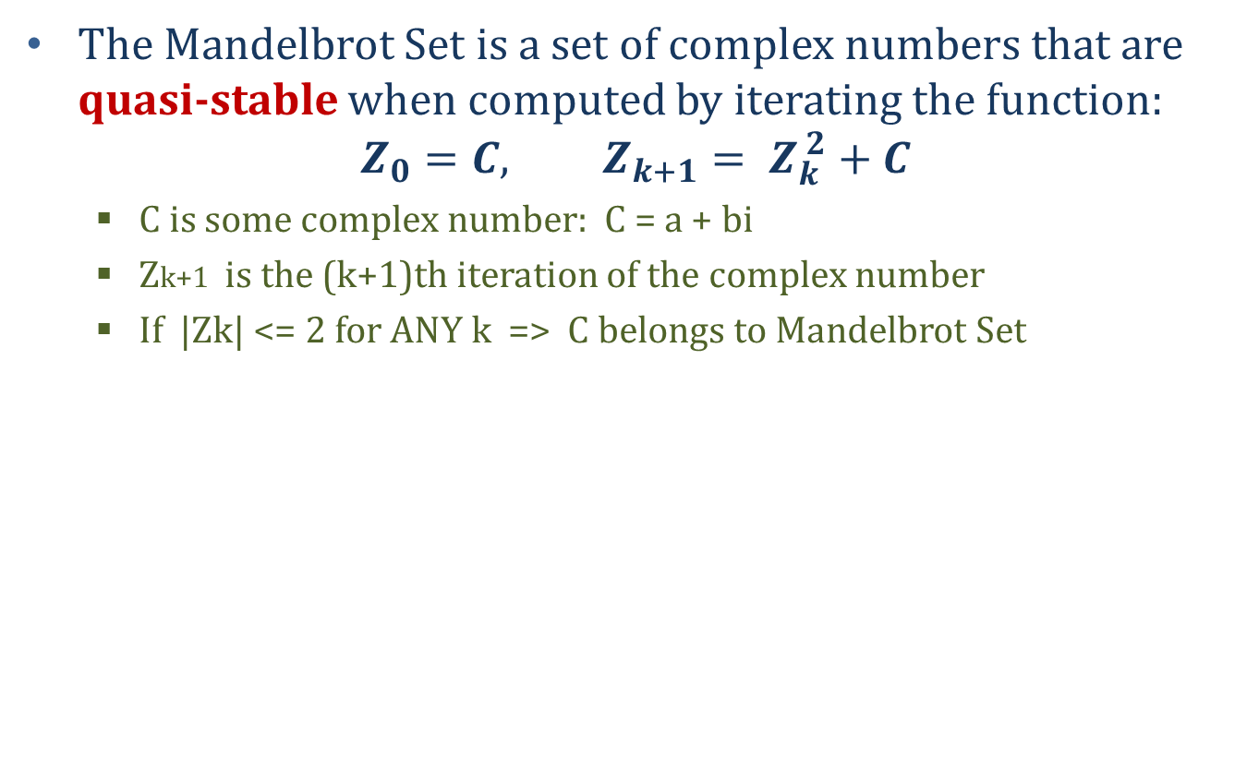
Problem Description
The Mandelbrot Set is a set of complex numbers that are quasi-stable when computed by iterating the function:
$$Z_{0}=C, Z_{k+1}= Z_{k}^{ 2}+C$$
C is some complex number: C = a + bi
Zk+1 is the (k+1)th iteration of the complex number
If |Zk| <= 2 for ANY k => C belongs to Mandelbrot Set

Slide 8

Problem Description(cont’d)
What exact is Mandelbrot Set?
It is a fractal: An object that display self‐similarity at various scale; Magnifying a fractal reveals small‐scale details similar to the large‐scale characteristics
After plotting the Mandelbrot Set determined by thousands of iteration:

Slide 9
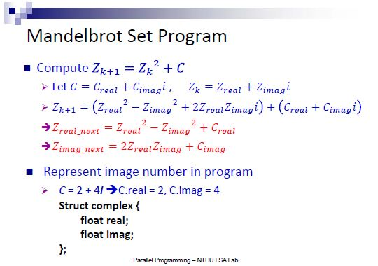
Problem Description(cont’d)

Slide 10
Problem Description(cont’d)
Requirement
Parallelize sequential program to MPI, OpenMP, and Hybrid (MPI + OpenMP) version
Both static and dynamic scheduling
Naming rules
Source Code: MS_${API}_${method}.c
${API} = MPI, OpenMP, Hybrid
${method} = static, dynamic
Example: MS_MPI_static.c, MS_Hybrid_dynamic.c ……
Executable: MS_${API}_${method}
Report: HW3_${student_id}_${name}.pdf
Compile
Example:
mpicc[/gcc] –o MS_Hybrid_dynamic –fopenmp –lX11 MS_Hybrid_dynamic.c

Slide 11
Outline
Goal
Problem Description
Input & Output format
Grading
Reference

Slide 12
Input & Output format
Input Parameters
./executable ${1} ${2} ${3} ${4} ${5} ${6} ${7} ${8}
Example: mpirun –n 2 ./MS_Hybrid_static 4 -2 2 -2 2 400 400 enable
${1}: number of threads
P.S. For pure MPI version, this parameter will not be used, but please just give it a number for maintaining the same format
${2}: left range for x-axis: [double]
${3}: right range for x-axis: [double]
${4}: lower range for y-axis: [double]
${5}: upper range for y-axis: [double]
${6}: number of points in x-axis: [int]
${7}: number of points in y-axis: [int]
${8}: display flag for Xwindow: [“enable” / “disable”]

Slide 13
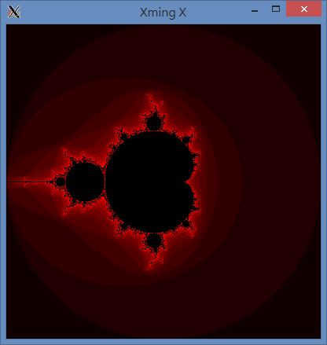
Input & Output format
mpirun –n 2 ./MS_Hybrid_static 4 -2 2 -2 2 400 400 enable
Y = 2
# points
= 400
Y = -2
# points = 400
X = -2
X = 2

Slide 14
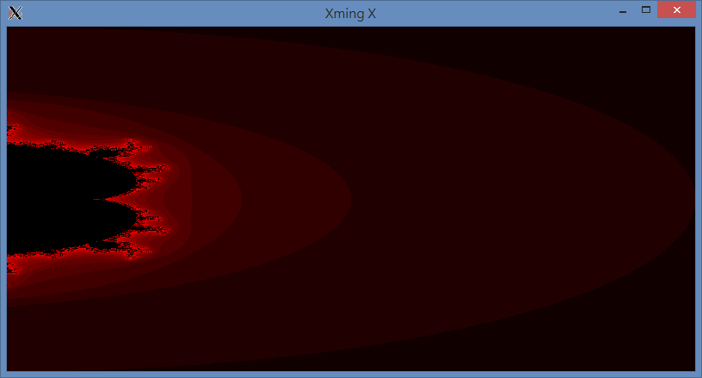
Input & Output format
./MS_OpenMS_static 4 0 2 -2 2 800 400 enable
Y = 2
# points
= 400
# points = 800
Y = -2
X = 0
X = 2

Slide 15
Outline
Goal
Problem Description
Input & Output format
Grading
Reference

Slide 16
Grading
Total six versions
Correctness: 50%
MPI version: 15%
OpenMP version: 15%
Hybrid version: 20%
Report: 30%
Design
Performance analysis
Scalability chart – strong & weak scalability
Load balance chart
Think as many interesting experiments as you can
Experience
What have you learned from this assignment?
What difficulty did you encounter when implementing this assignment?
Demo: 20%

Slide 17
Scalability chart
#core is fixed

Slide 18
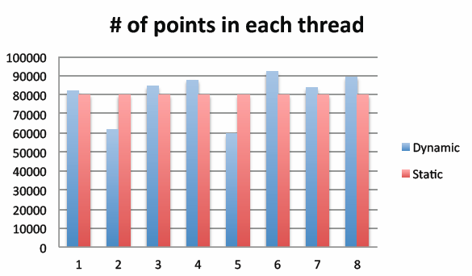
Load balance chart
thread ID / MPI_task ID

Slide 19
Grading (cont’d)
Deadline: 12/14 (Sun.) 23:59
Late submission penalty policy please refer to syllabus.
Please compress all of your source codes and report in the file named ${ID}_${name}_HW3.zip and upload to iLMS
Please disable the display of Xwindow functions when submitting the job to computation nodes

Slide 20
Outline
Goal
Problem Description
Input & Output format
Grading
Reference

Slide 21
Reference
Xwindow
For mac & MobaXterm user
Example: ssh s100062101@140.114.91.171 –p 10000 -X
For putty user
Step1: Download and install Xming
Step2: Enable X11 forwarding for putty

Slide 22
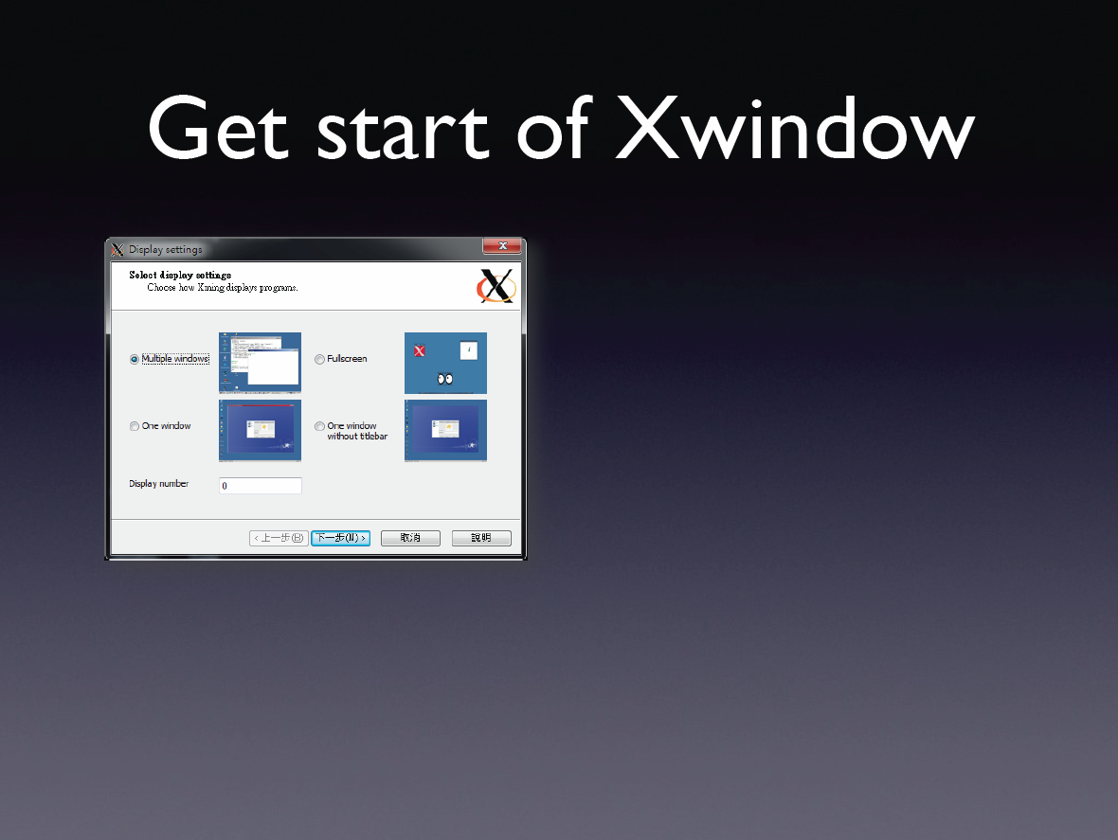
Reference (cont’d)

Slide 23
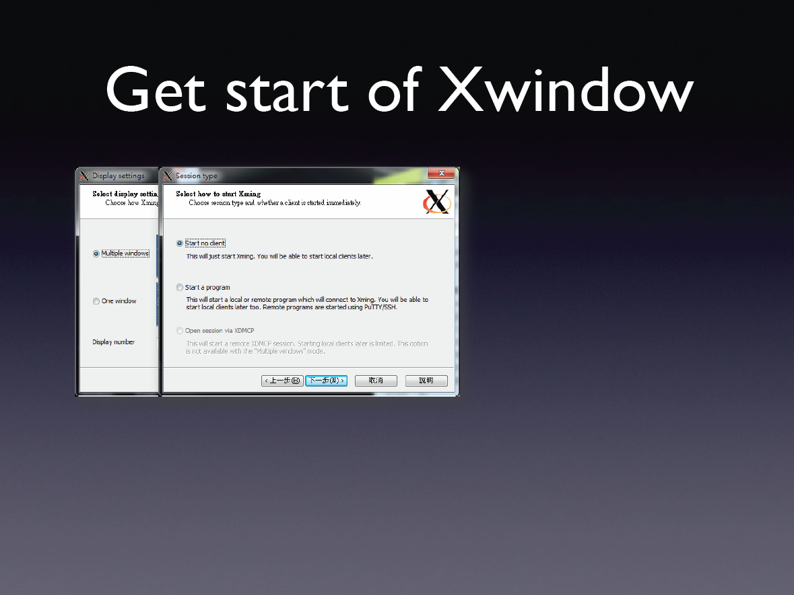
Reference (cont’d)

Slide 24
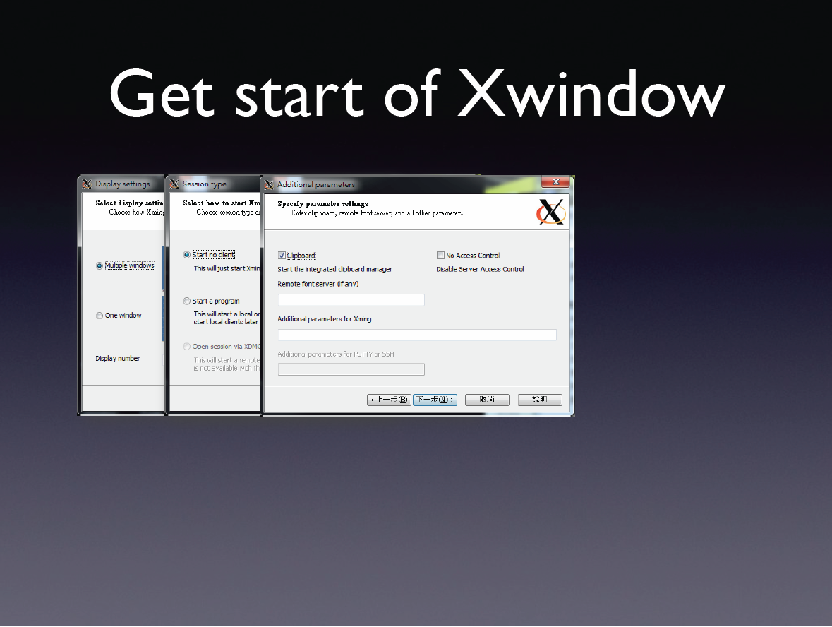
Reference (cont’d)

Slide 25
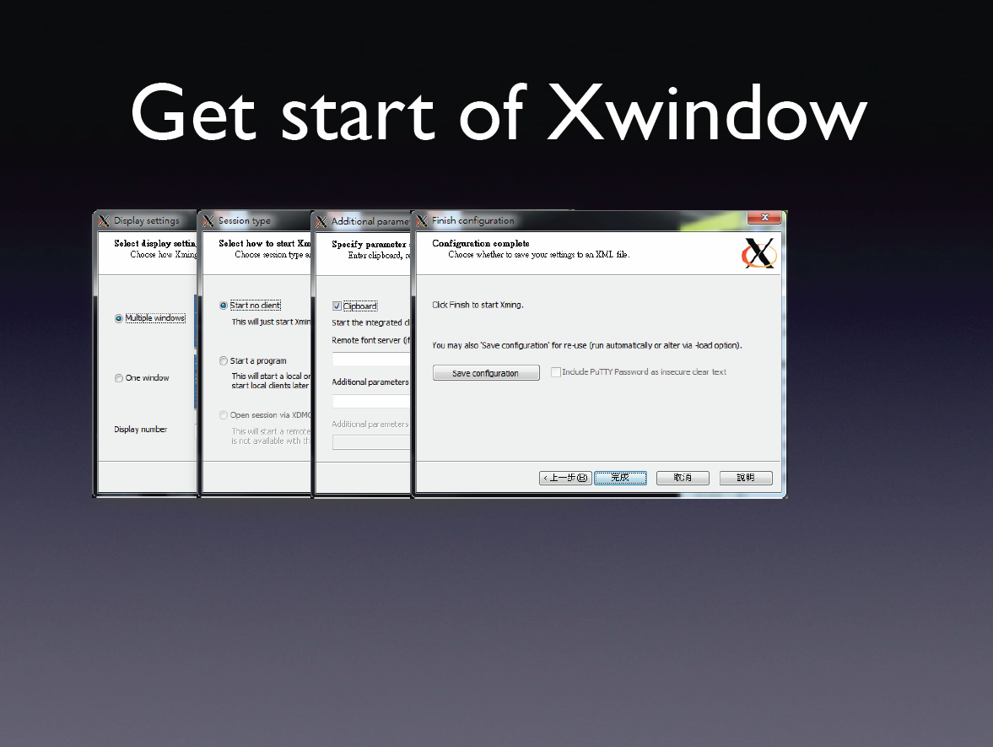
Reference (cont’d)

Slide 26
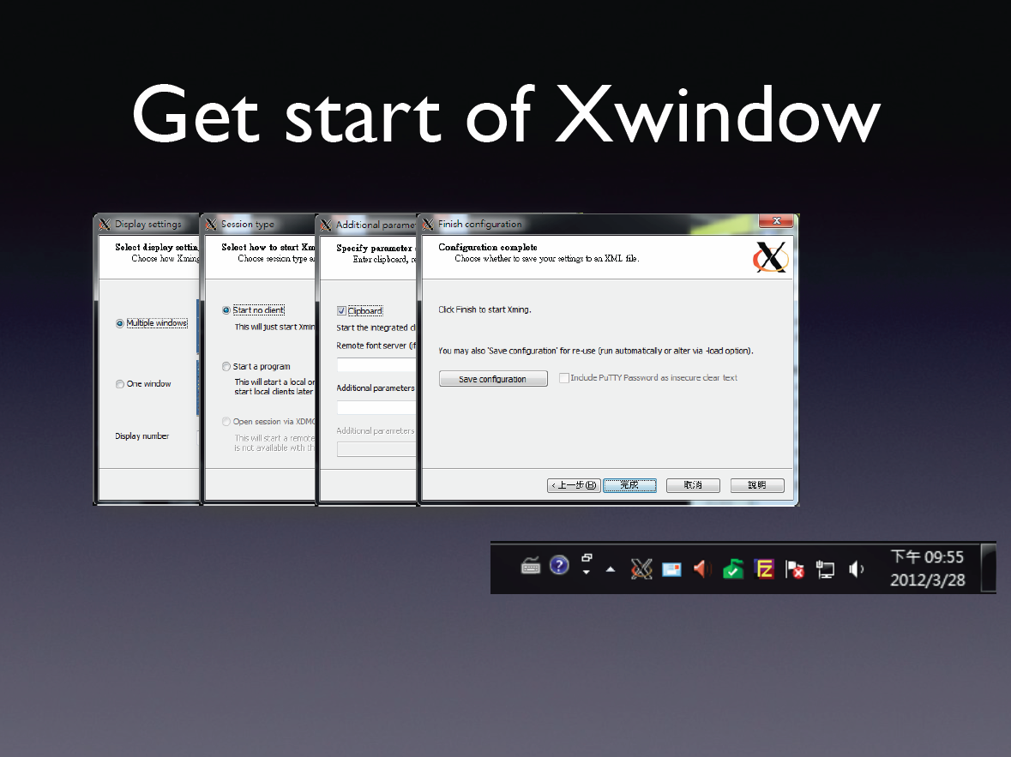
Reference (cont’d)

Slide 27
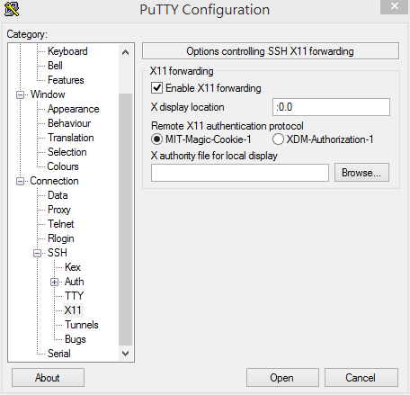
Reference (cont’d)
Open putty
Load host name
Choose X11
Enable x11 forwarding
Type “:0.0”

Slide 28
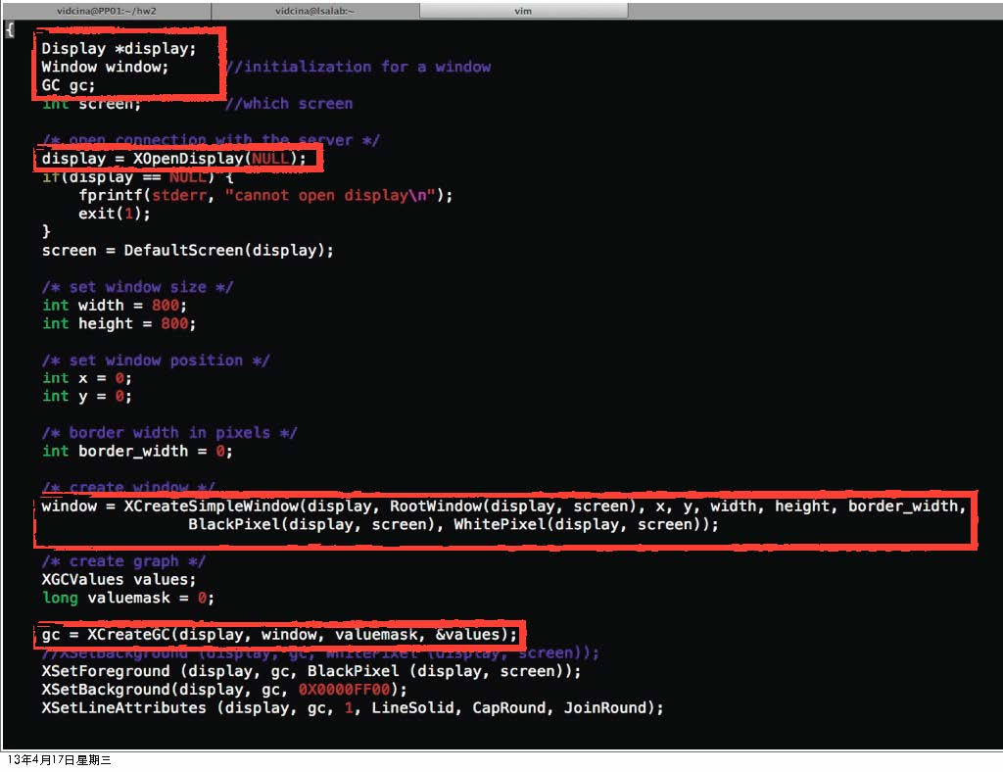

Slide 29
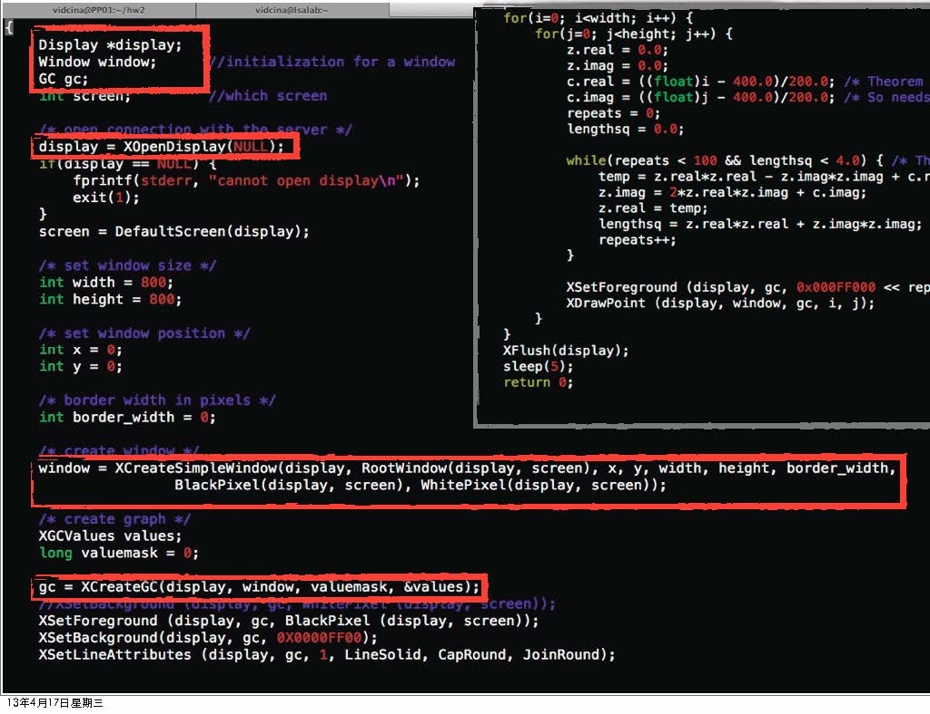

Slide 30
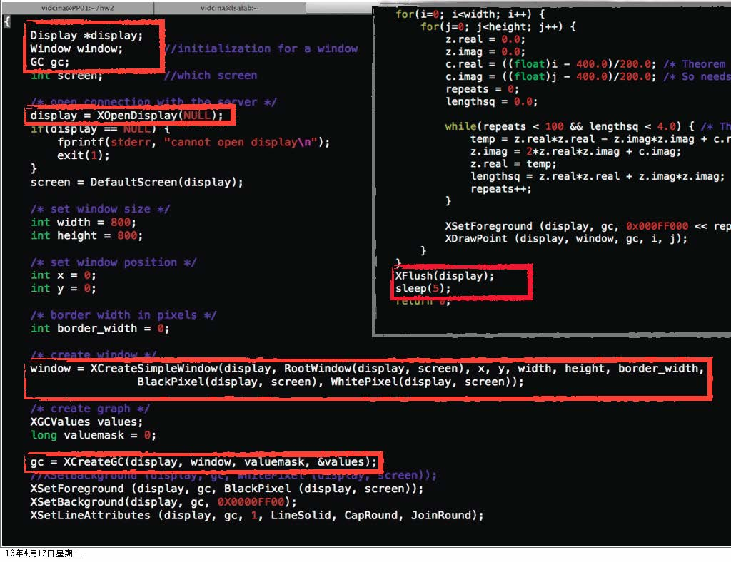

Slide 31
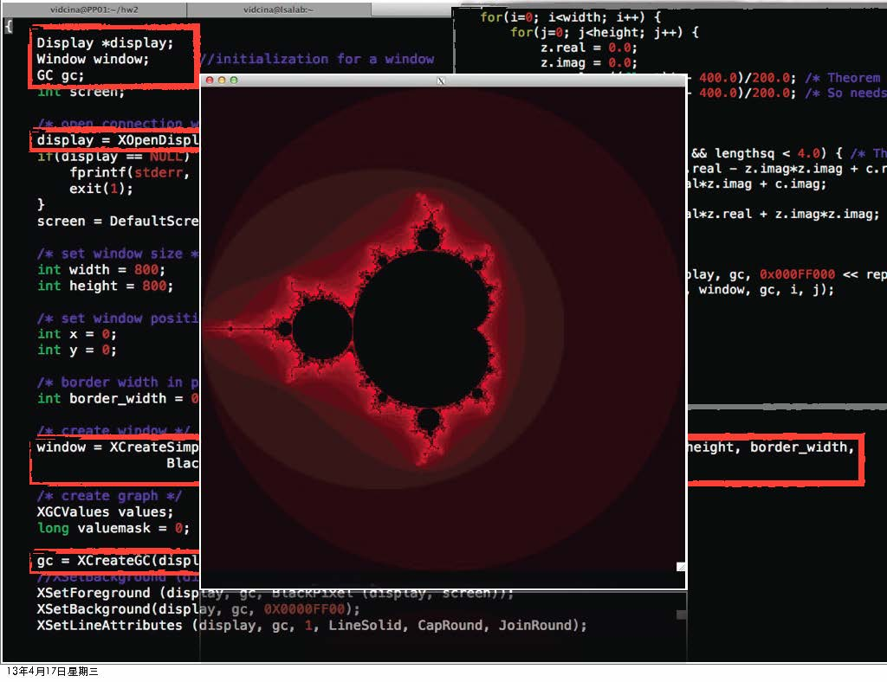

Slide 33
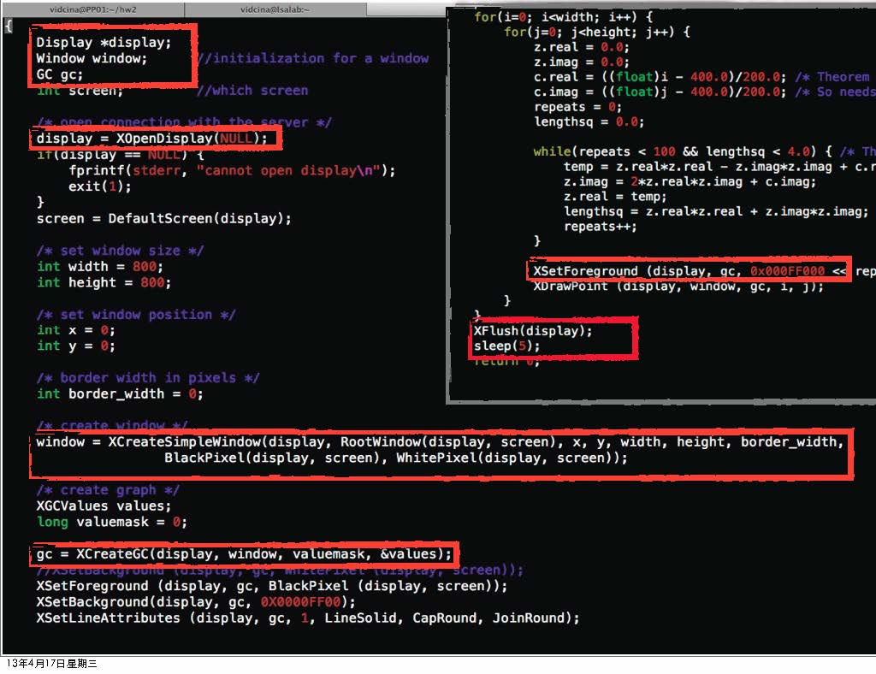

Slide 34
Reference
Xming download
http://sourceforge.net/projects/xming/files/latest/download
Wikipedia
http://en.wikipedia.org/wiki/Mandelbrot_set
Mandelbrot Set Tutorial
http://warp.povusers.org/Mandelbrot/
For more information of Xwindow, please see the attachment on iLMS
Lecture notes of Parallel Programming by Pf. Jerry Chou

Slide 35
Thank you for listening !

